Slide 1
CSIT940:
CS Research Methodology Spring Session 2024
Literature Review on
Multi-Model Fatigue Detection: Analyzing Physical Signals to Identify Driving Fatigue
Progress Presentation
<Yinqiao Li>

Slide 2
Problem Statement
Driver fatigue
20% of total accidents annually
3 rd leading cause of death and disability
Current conventional visualization methods not works effectively.
Notes:
Driver fatigue is a significant factor in many vehicular accidents, with statistics indicating that sleepiness contributes to roughly 20% of total accidents annually. The societal and economic costs of road traffic injuries are escalating, and by 2020, traffic incidents are projected to become the third leading cause of death and disability. Current conventional visualization methods for detecting driver fatigue, such as monitoring yawning or blinking by AU, are reactive and do not effectively estimate fatigue. There is a critical need for a proactive system that can measure physiological changes and predict fatigue to prevent accidents before they occur.

Slide 3
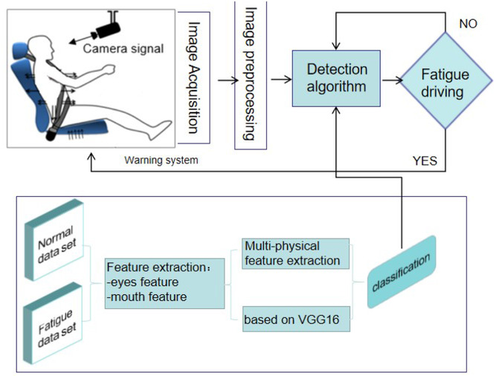
Why is the Problem Important
Notes:
Here is a common procedure of traditional visual method to detect driving fatigue. The computer processes the video information by eyes feature and mouth feature.

Slide 4
Why is the Problem Important
An Effective source of information is neglected…
Notes:
In this way, this single model, an Effective source of information is neglected…

Slide 5
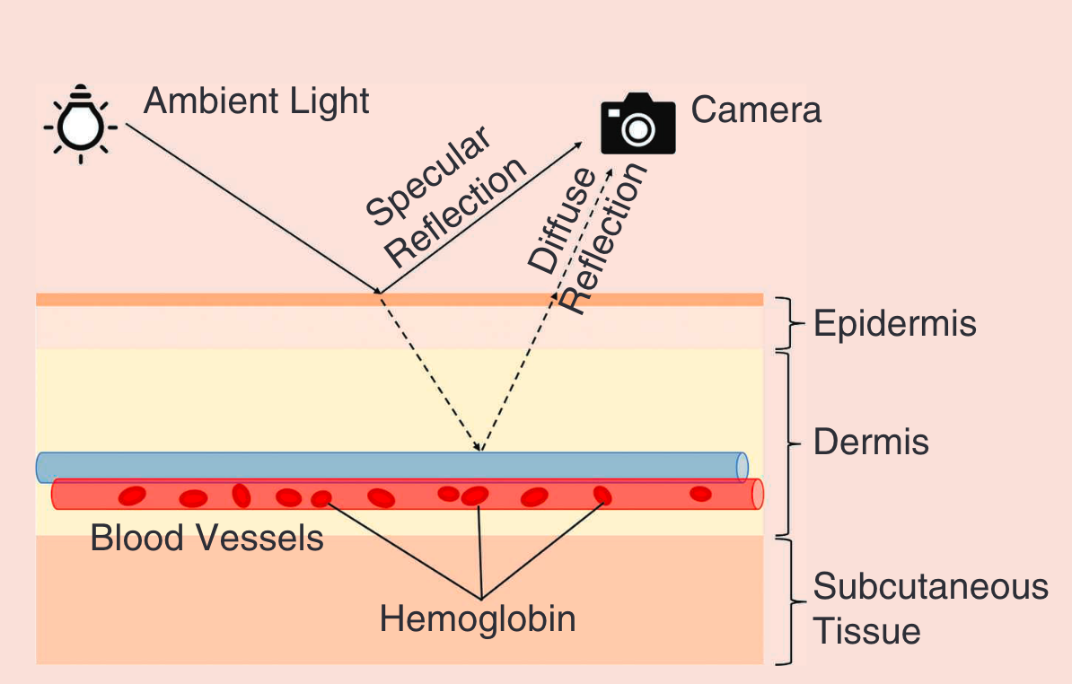
Extracting signal by rPPG
(Remote Photople/thysmography)
Notes:
rPPG technology estimates heart rate by detecting blood volume changes in facial tissue using subtle variations in skin color captured via camera.
Photople/thysmography

Slide 6
Extracting signal by rPPG
Traditional method (Signal Processing)
  Conventional methods based on BSS[1]
  Conventional methods based on models[2]
Supervised deep learning method (Neural Networks)
  2D convolutional neural network (2D CNN) method[3]
  3D convolutional neural network (3D CNN) method[4]
  LSTM method[5]——Bigsmall
  Transformer methods[6]
Notes:
Traditional method is more about Signal Processing
Especially the BSS method, Extracting pulse rate from color signals in videos
While supervised method concentrates on predict HR by neural networks by 2D CNN or 3D CNN. In the recent years more scholars find LSTM is a proper method to implement on rPPG signal, for it is more about temporal signal processing.时序特征的重要性
One paper I have to mention is Bigsmall, a very smart model.

Slide 7
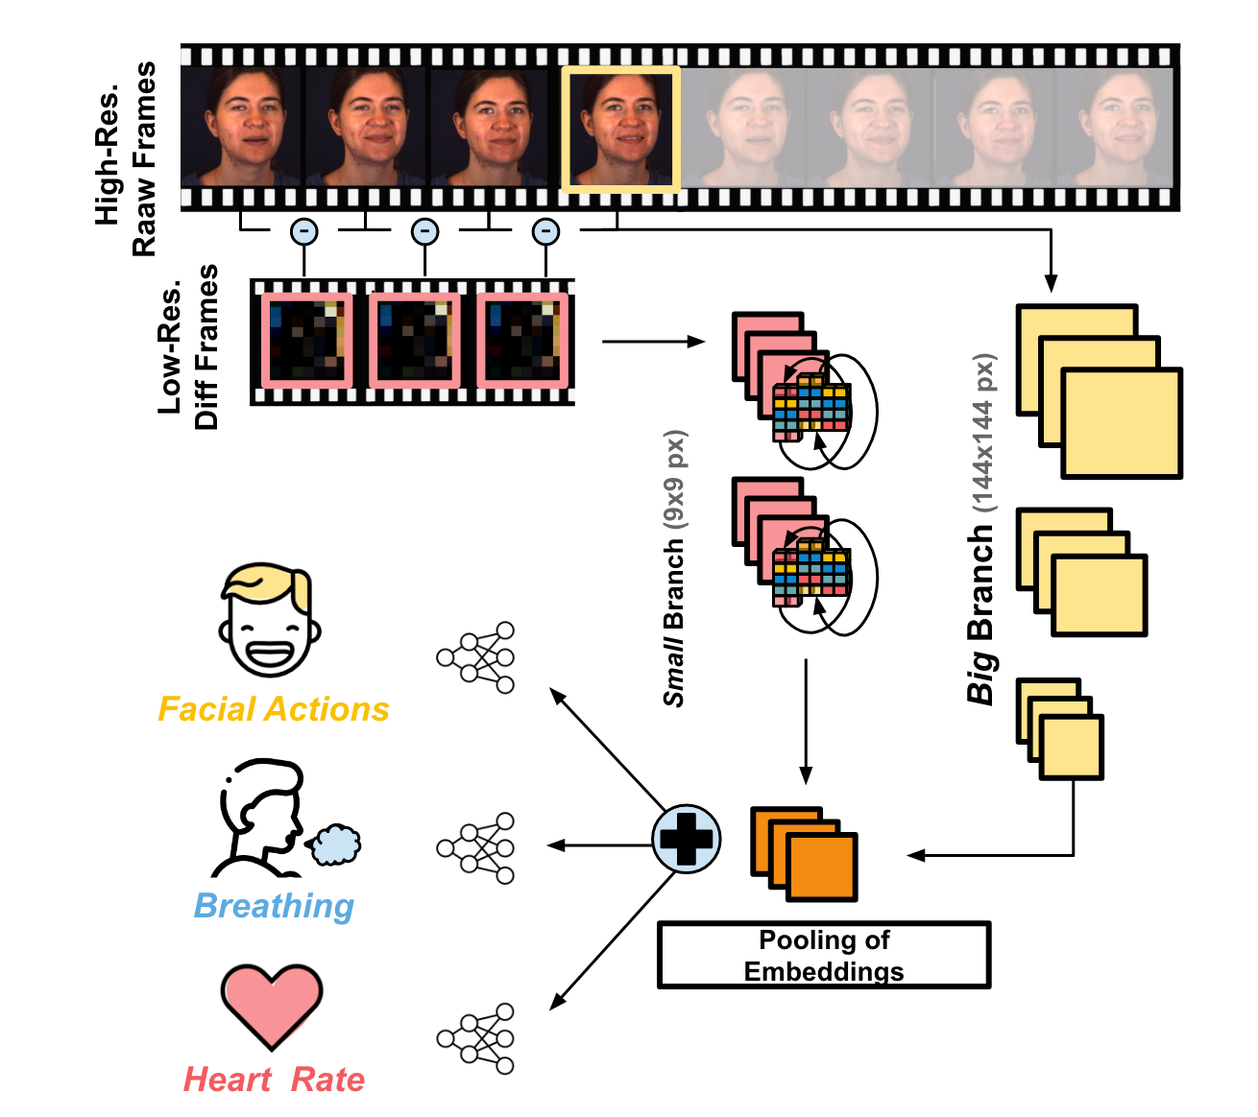
Notes:
It utilize the feature of principle of rPPG processing. When we extract rppg, we do not have to use high quality source, for it extracts signal by color variance. So it use two networks, one big networks to use AU for facial actions, and one small for rppg processing.

Slide 8
Big branch
High Resolution
Tradition CV Processing by AU
Small branch
Low Resolution
rPPG Extraction
Temporal information matters.
Notes:
It utilize the feature of principle of rPPG processing. When we extract rppg, we do not have to use high quality source, for it extracts signal by color variance. So it use two networks, one big networks to use AU for facial actions, and one small for rppg processing.

Slide 9
[1]Y. Sun, S. Hu, V. Azorin-Peris, S. Greenwald, J. Chambers, Y. Zhu, Motion-compensated noncontact imaging photoplethysmography to monitor cardiorespiratory status during exercise, J. Biomed. Opt. 16 (7) (2011) 077010.
[2] G. De Haan, V. Jeanne, Robust pulse rate from chrominance-based rPPG, IEEE Trans. Biomed. Eng. 60 (10) (2013) 2878–2886.
[3] W. Chen, D. McDuff, Deepphys: Video-based physiological measurement using convolutional attention networks, in: Proceedings of the European Conference on Computer Vision, ECCV, 2018, pp. 349–365.
[4] Z. Yu, W. Peng, X. Li, X. Hong, G. Zhao, Remote heart rate measurement from highly compressed facial videos: an end-to-end deep learning solution with video enhancement, in: Proceedings of the IEEE/CVF International Conference on Computer Vision, 2019, pp. 151–160.
[5] Narayanswamy, G., Liu, Y., Yang, Y., Ma, C., Liu, X., McDuff, D., & Patel, S. (2024). Bigsmall: Efficient multi-task learning for disparate spatial and temporal physiological measurements. In Proceedings of the IEEE/CVF Winter Conference on Applications of Computer Vision (pp. 7914-7924).
[6] Fan, Huiting, et al. "Transformer-based multimodal feature enhancement networks for multimodal depression detection integrating video, audio and remote photoplethysmograph signals." Information Fusion 104 (2024): 102161.
Notes:
And here is the bib I mentioned before

Slide 10
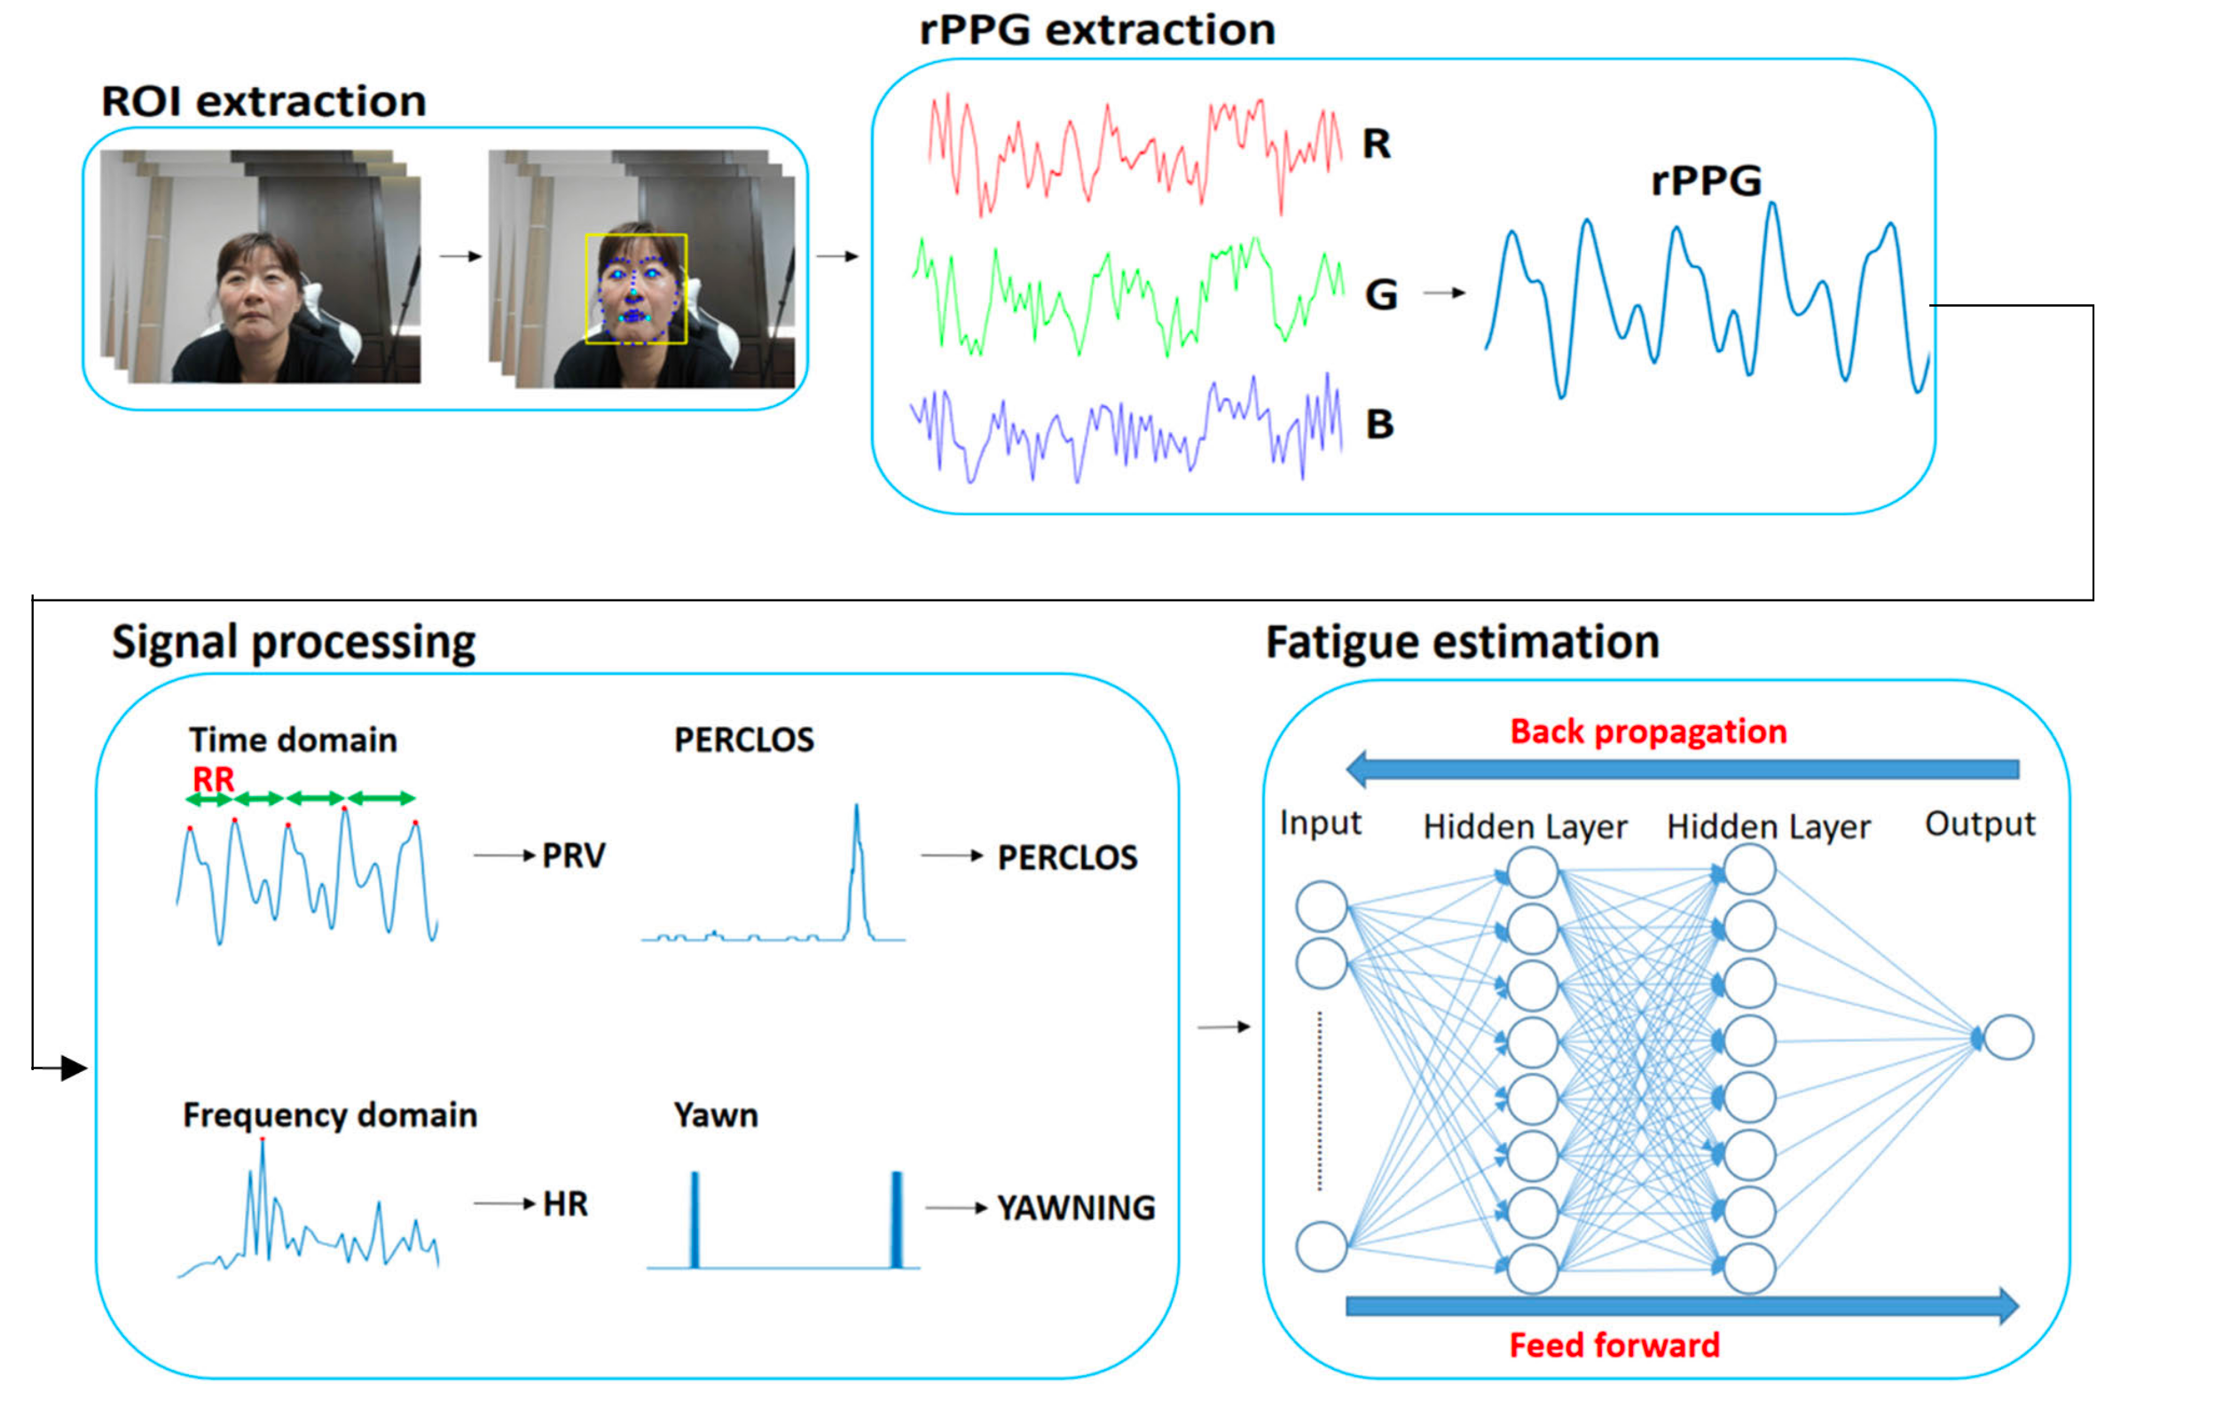
Extracting signal by rPPG
Notes:
Maybe some of the article is more about emotion and rppg extraction. But actually, after we extract the signal by traditional method or we have a neural network, driving fatigue detection is a same thing.
We can extract much information by physiological signal. We can use rppg to do emotion classsification by HRV or PRV, if you have a smart watch you can get HRV data to evaluate your emotional state, the higher, the better.

Slide 11
Feature1: PERCLOS, the percentage of eyelid closure over the pupil over time
Notes:
I plan to utilize two feature: Perclos is a index of the blink of Eye per minute.

Slide 12
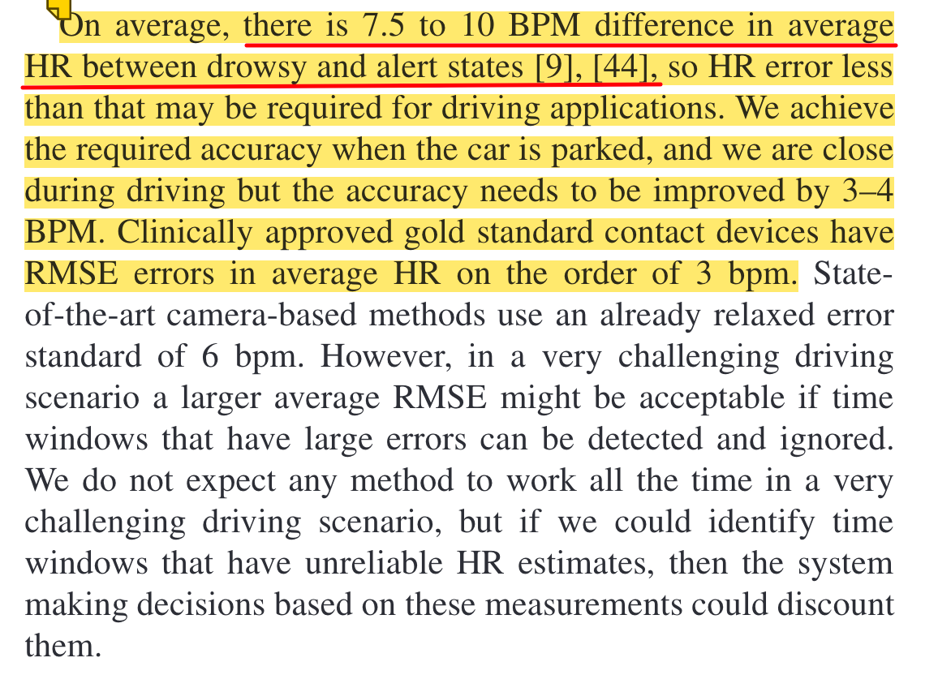
Feature 2: Average difference of BPM
Nowara, Ewa M., et al. "Near-infrared imaging photoplethysmography during driving." IEEE transactions on intelligent transportation systems 23.4 (2020): 3589-3600.
Notes:
And another is the av BPM.

Slide 13
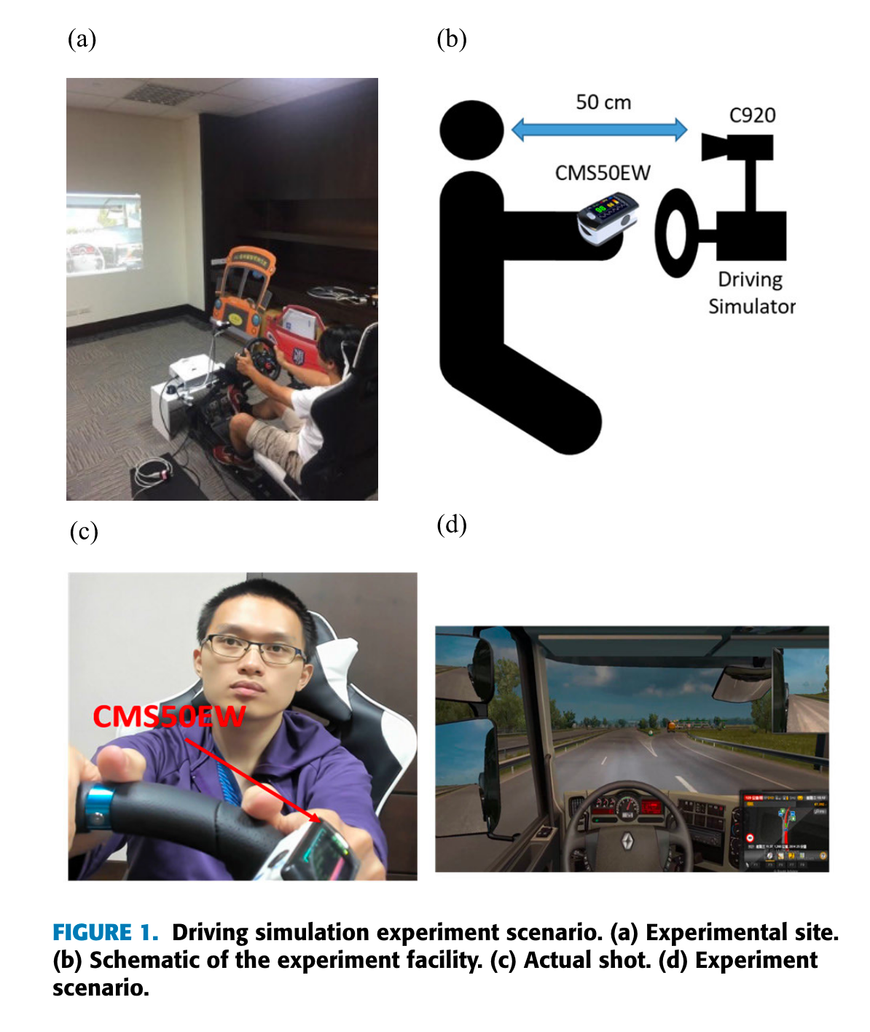
My Research Plan
Tsai, Yin-Cheng, et al. "Vision-based instant measurement system for driver fatigue monitoring." IEEE Access 8 (2020): 67342-67353.
Notes:
And here is the experiment process conducted by YIN-CHENG TSAI et al.

Slide 14
My Research Plan
Literature Collection (Week6)
Literature Organization (Week6)
Literature Analysis (Week7)
Writeup of the Lit. Review (when7)
Revision (Week8)

Slide 15
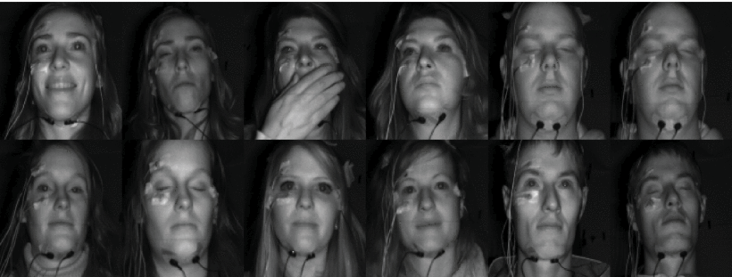
Tasks Completed
Literature Review Accumulation ✅
Project Selection and Environment Setup ✅
Configuration of Basic Config Files and Model Selection ✅
Dataset Application✅
Training
Testing & Validation

Slide 16
Tasks for the FUTURE…
Creating Custom Datasets (optional)
Training
Feature Fusion Optimization
Testing & Validation
Write a paper based on my research and LR.

